Slide 1
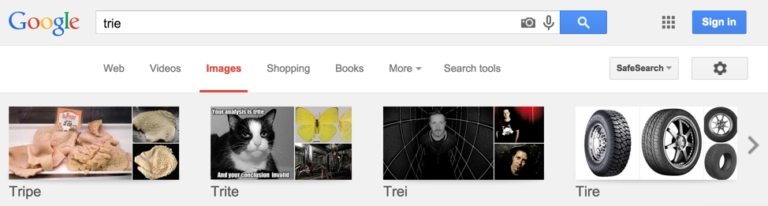
CS61B
Lecture 37: Tries
Tries
Trie Implementation
Child Link Optimizations
Ternary Search Tries

Slide 2
Search-By-Key-Identity Data Structures:
BST
Searches using compareTo()
Analogous to Comparison-Based
Set
2-3 Tree
RedBlack
Map
External Chains
Searches using hashCode() and equals()
Roughly Analogous to Integer Sorting
Linear Probing
Comparison Based Sorting Algorithms:
Digit-by-digit Sorting Algorithms:
(require a sorting subroutine)
Selection
If heapify first
Heapsort
??
Merge
LSD
Partition
Counting
MSD
Insertion
If insert into BST, eq. to
??
Small-Alphabet (e.g. Integer) Sorting Algorithms:
??
Counting
??

Slide 3
Search-By-Key-Identity Data Structures:
BST
Searches using compareTo()
Analogous to Comparison-Based
Set
2-3 Tree
RedBlack
Map
External Chains
Searches using hashCode() and equals()
Roughly Analogous to Integer Sorting
Linear Probing
Searches uses … digits?
Analogous to digit-by-digit (radix) sorting.

Slide 4
Tries

Slide 5
Digit-by-digit Search
Suppose we insert “sam”, “sad”, “sap”, “same”, “a”, and “awls”
Try to insert the rest.
s
a
d
m

Slide 6
Digit-by-digit Search
Suppose we insert “sam”, “sad”, “sap”, “same”, “a”, and “awls”
contains(“sam”): true, blue node
contains(“sa”): false, white node
contains(“a”): true, blue node
contains(“”): false
contains(“saq”): false
We have a search “miss”:
If the final node is white.
If we fall off the tree, contains(“z”)
a
s
w
a
l
d
m
p
s
e

Slide 7
Digit-by-digit Search
Suppose we insert “sam”, “sad”, “sap”, “same”, “a”, and “awls”
a
s
w
a
l
d
m
p
s
e
For an animated demo, see demo from Algorithms textbook.

Slide 8
Tries: A Digit-by-Digit Set Representation
a
s
sad
0
1
2
3
sad
sam
awls
w
a
awls
same
a
sap
l
d
m
p
a
sam
sap
same
s
e
BST
HashSet
Trie
DAWG

Slide 9
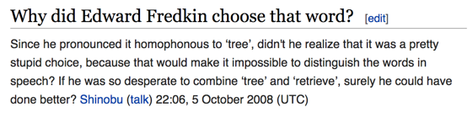
Tries
Trie:
Short for Retrieval Tree.
Pronounced same as tree:
I’ll pronounce as “try”, like everyone else except its inventor, Edward Fredkin.

Slide 10
Trie Performance in Terms of N and L
Given a Trie with N keys, and a key with L digits. What is the: [n = 6]
Worst case insert runtime?
Worst case search runtime?
Best case search runtime?
Assume child can be found in constant time.
Bonus Q: How do these compare to a hash table?
a
s
w
a
l
d
m
p
s
e

Slide 11
Trie Performance in Terms of N and L
Given a Trie with N keys, and a key with L digits. What is the:
Worst case insert runtime? Θ(L)
Worst case search runtime? Θ(L)
Best case search runtime? Θ(1)
Corresponds to a miss on first digit.
Hash table (search): Θ(NL) worst case, Θ(L) typical case, Θ(L) best case.
a
s
w
a
l
d
m
p
s
e

Slide 12
Set/Map Data Structures (Raw Performance for Search)
Runtimes for contains()
 | Amortized average | Worst case | Best case
BST (Balanced) |  | Θ(L log N) | Θ(L) (hit)
Trie |  | Θ(L) | Θ(1) (miss)
Hash Table | Θ(L)* | Θ(NL)
N keys, L digits per key. A “miss” means the key isn’t present.
Performance for tries:
Like BSTs, comparison is done digit-by-digit, allowing us to skip some characters.
Hash tables may look at many unnecessary characters (see sp15 midterm #6b) as the full hashCode needs to be computed.
Like hash tables, searching is constant with respect to the number of keys.

Slide 13
Usages of Tries
Theoretical asymptotic speed improvement is nice, but main appeal of tries is their ability to support rapid prefix matching and approximate matching.
Finding all keys that match a given prefix: keysWithPrefix(“sa”)
Finding longest prefix of: longestPrefixOf(“sample”)
sad
0
1
2
3
sad
sam
a
s
awls
awls
same
w
a
a
sap
a
sam
sap
l
d
m
p
same
s
e

Slide 14
Trie Implementation
and Usage

Slide 15
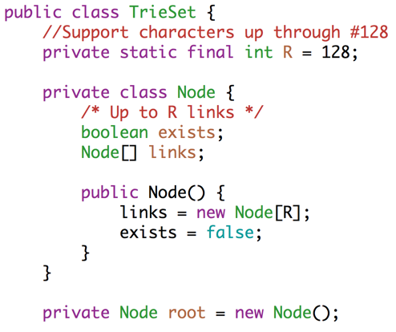
Trie Implementation
The somewhat counter-intuitive but easiest Java representation of a Trie does not store letters inside nodes, instead letter is stored implicitly on each link.
a
s
w
a
l
d
m
p
s
e

Slide 16
Trie Implementation
The somewhat counter-intuitive but easiest Java representation of a Trie does not store letters inside nodes, instead letter is stored implicitly on each link.
a
s
...
w
a
...
...
l
...
...
d
...
...
...

Slide 17
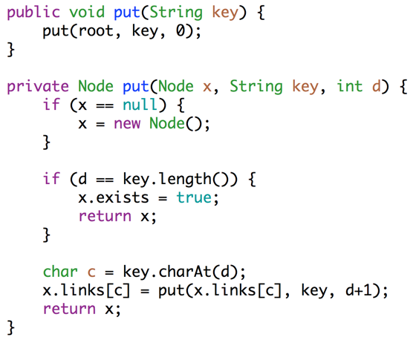
Trie Implementation

Slide 18
Usages of Tries
Theoretical asymptotic speed improvement is nice, but main appeal of tries is their ability to support rapid prefix matching and approximate matching.
Finding all keys that match a given prefix: keysWithPrefix(“sa”)
sad, sam, same, sap
Finding longest key starting with: longestPrefixOf(“sample”)
sam
Won’t cover implementations of these two ops in lecture.
… but let’s try designing one of them.
a
s
w
a
l
d
m
p
s
e

Slide 19
Usages of Tries
Theoretical asymptotic speed improvement is nice, but main appeal of tries is their ability to support rapid prefix matching and approximate matching.
Finding all keys that match a given prefix: keysWithPrefix(“sa”)
sad, sam, same, sap
Finding longest key starting with: longestPrefixOf(“sample”)
sam
Give an algorithm for longestPrefixOf.
(Bonus question: Give an algorithm for keysWithPrefix)
a
s
w
a
l
d
m
p
s
e

Slide 20
Usages of Tries
Theoretical asymptotic speed improvement is nice, but main appeal of tries is their ability to support rapid prefix matching and approximate matching.
Finding all keys that match a given prefix: keysWithPrefix(“sa”)
sad, sam, same, sap
Finding longest key starting with: longestPrefixOf(“sample”)
sam
Give an algorithm for longestPrefixOf.
Check each digit in turn, walking down the tree,
Keeping track of the most recent blue thing.
At some point you find the next isn’t there, then
Return that most recent blue thing.
a
s
w
a
l
d
m
p
s
e

Slide 21
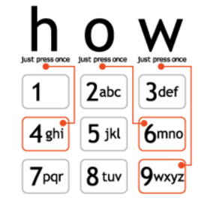
T9 Texting
For non smart-phone users, texting usually involves coopting your number buttons to type messages.
Approach #1, multi-tapping the word good:
good: 4 666 666 3
Approach #2, T9 text-input:
Type 4663, choices: good, home, gone, hoof.
Press * to select next option.
Press 0 to see all options.
Adapts to user’s tendencies.

Slide 22
Implementing T9 Texting
How would you implement T9? TrieSet<?> TrieMap<?, ?>
Type 4663, choices: good, home, gone, hoof.
Press * to select next option.
Press 0 to see all options.
Adapts to user’s tendencies.

Slide 23
Implementing T9 Texting
How would you implement T9?
Type 4663, choices: good, home, gone, hoof.
Press * to select next option.
Press 0 to see all options.
Adapts to user’s tendencies.

Slide 24
Implementing T9 Texting (My Answer)
.get(4663) → {good home …}
How would you implement T9?
Type 4663, choices: good, home, gone, hoof.
Press * to select next option.
Press 0 to see all options.
Adapts to user’s tendencies.
TrieMap<String, TreeSet<WeightedWord>>:
Alphabet (R=8): 2 through 9
Key: Sequences of numbers (e.g. 4663)
Value: All possible words: {good, home, gone, hoof, hood}
TreeSet<WeightedWord> where a WeightedWord is a string with a compareTo method that contains some sort of weight.
When a word is used, increase its weight, moving its position in the TreeSet if necessary.
A TreeMap or HashMap would have worked instead of a TrieMap as well.

Slide 25
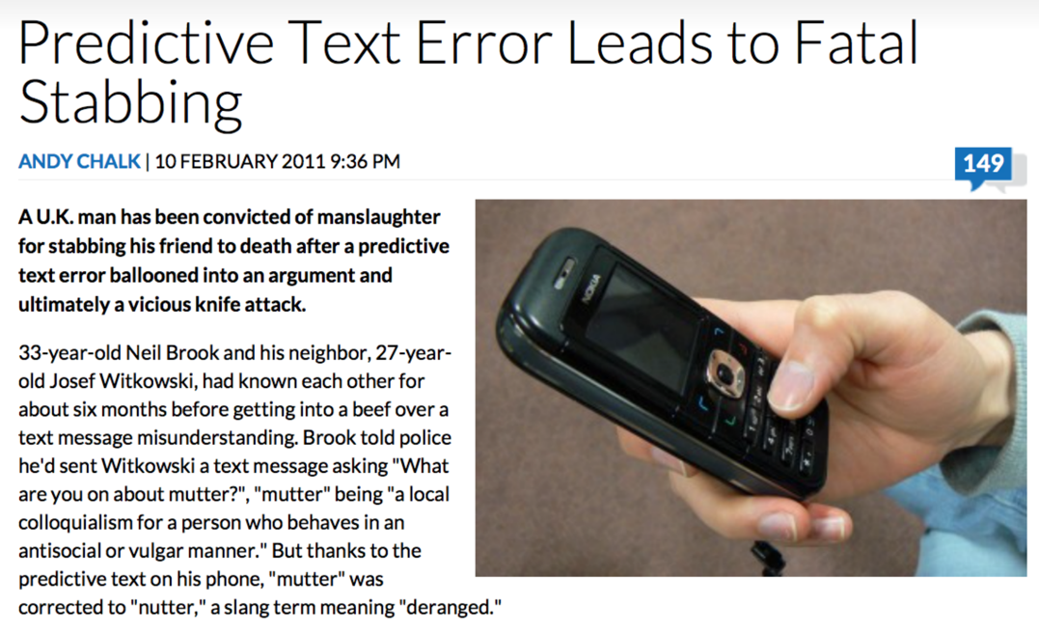
Caveat
http://www.escapistmagazine.com/news/view/107702-Predictive-Text-Error-Leads-to-Fatal-Stabbing

Slide 26
Tries
Excellent performance, support character-based operations.
Naive implementation is extremely memory hungry.
Fundamental issue, mapping from a node to its children is done with a data-indexed array (of size R).
Why so much memory? Every node uses R memory.
Memory usage can be improved through various optimizations:
Tracking children in a better way than with an array of length R.
Ternary Search Tries
Patricia/Radix Tries
DAWG
Suffix/Prefix Array

Slide 27
Child Link Optimizations

Slide 28
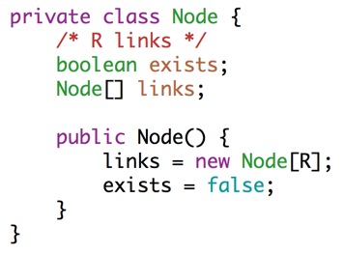
More Accurate Visualization for an Array Based Trie
Each node has R links, where R is the alphabet size.
a
s
w
a
l
d
How can we save memory?

Slide 29
Even More Accurate Visualization for an Array Based Trie
exists:
F
links:
...
97
98
99
100
...
exists:
exists:
T
F
links:
links:
...
97
98
99
100
...
...
97
98
99
100
...
a
c
exists:
T
links:
Fundamental problem, our arrays are ‘sparse’.
d
How can we save memory?
...
97
98
99
100
...

Slide 30
Visualization for a BST Based Trie
exists:
F
links:
‘c’
‘a’
a
c
exists:
F
exists:
T
d
links:
links:
‘d’
exists:
T
links:

Slide 31
Generalizing our Trie Implementation
What abstraction can we use in place of the Node[] array that is more general?

Slide 32
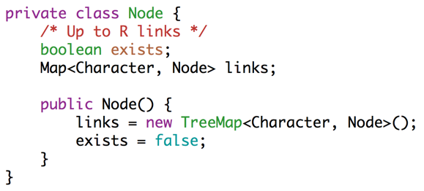
A More Modular TrieSet
Replace array with a Map.
Version above still requires hard coded choice of map instantiation i.e HashMap vs TreeMap.

Slide 33
A More Modular TrieSet
Replace array with a Map.
Each choice of map comes with its own runtime / space tradeoff:
Data-indexed array: Max speed, max memory.
TreeMap/HashMap: Slower query performance, but less memory wasted.
Can mitigate performance issues by initializing HashMap to be small

Slide 34
Ternary Search Tries

Slide 35
Ternary Search Trie: Restricting the Number of Links
Alternately approach: Redesign Trie so that we have a fixed number of links.
One approach: The Ternary Search Trie
Assign a character to each node.
Give each node 3 links:
Left link if key’s next character < node’s character.
Middle link if key’s next character == node’s character.
Right link if key’s next character > node’s character.

Slide 36
Ternary Search Trie
After inserting “sam”
s
a
a
s
w
a
m
l
d
m
p
s
e
Animated Demo: http://goo.gl/dq1EDa

Slide 37
Ternary Search Trie
After inserting “sam”, “sad”
s
a
a
s
w
a
m
l
d
m
p
d
s
e
Animated Demo: http://goo.gl/dq1EDa

Slide 38
Ternary Search Trie
After inserting “sam”, “sad”, “sap”
s
a
a
s
w
a
m
l
d
m
p
d
p
s
e
Animated Demo: http://goo.gl/dq1EDa

Slide 39
Ternary Search Trie
After inserting “sam”, “sad”, “sap”, “same”
s
a
a
s
w
a
m
l
d
m
p
d
e
p
s
e
Animated Demo: http://goo.gl/dq1EDa

Slide 40
Ternary Search Trie
After inserting “sam”, “sad”, “sap”, “same”, “a”
s
a
a
a
s
w
a
m
l
d
m
p
d
e
p
s
e
Animated Demo: http://goo.gl/dq1EDa

Slide 41
Ternary Search Trie
After inserting “sam”, “sad”, “sap”, “same”, “a”, and “awls”
s
a
a
a
s
w
a
w
m
l
d
m
p
l
d
e
p
s
e
s
Animated Demo: http://goo.gl/dq1EDa

Slide 42
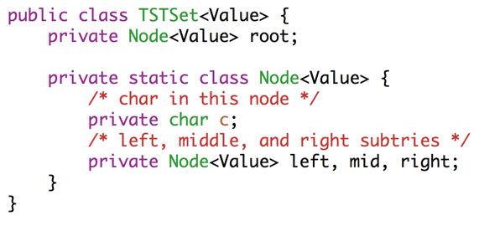
TST Implementation
Full implementation available from Algorithms textbook.

Slide 43
TST Performance
Give an example of a sequence of insert operations that results in much worse performance than a standard trie.

Slide 44
TST Performance
Give an example of a sequence of insert operations that results in much worse performance for a TST than a standard trie.
insert(“A”)
insert(“B”)
insert(“C”)
insert(“D”)
a
b
c
d

Slide 45
Set/Map Data Structures
Runtimes for contains()
 | Amortized average | Worst case | Best case (miss) | Memory
Hash Table | Θ(L)* |  |  | Θ(NL)
BST |  | Θ(L log N) | Θ(1) | Θ(NL)
Trie (array map) |  | Θ(L) | Θ(1) | Θ(NLR)
Trie (HashMap) |  | Θ(L) | Θ(1) | Θ(NL)
Trie (TreeMap) |  | Θ(L log R) | Θ(1) | Θ(NL)
TST |  | Θ(NL) | Θ(1) | Θ(NL)
Tries and TSTs:
Performance improvement over previous data structures.
Support character-based operations
Various implementations trade off memory vs. time.
N keys, L digits per key, R alphabet size. A miss means the key isn’t present.

Slide 46
Search-By-Key-Identity Data Structures:
BST
Set
2-3 Tree
Searches using compareTo()
Analogous to Comparison-Based
RedBlack
Map
External Chains
Searches using hashCode() and equals()
Roughly Analogous to Integer Sorting
Linear Probing
R-way Array Trie
R-way Map Trie
Searches uses digits.
Analogous to digit-by-digit (radix) sorting.
Ternary Search Trie

Slide 47
Extra Fall 2014 Slides:
A Tricky OOP Exercise Somewhat Beyond the Scope of 61B

Slide 48
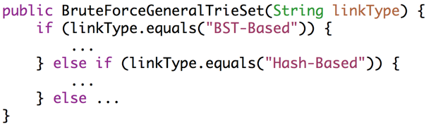
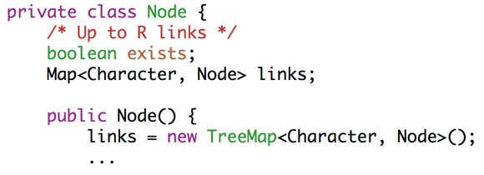

Further Generalizing our Trie Implementation
As an OOP exercise, let’s consider how we might further generalize.
Idea: Let client decide how links are handled.
Better ideas?

Slide 49
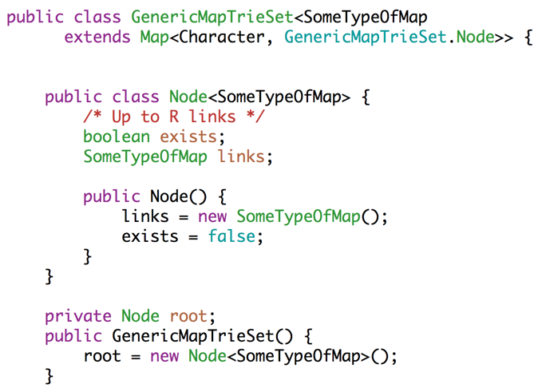
Approach #1: Use Generics?
Can we somehow use generics? This approach is doomed. Why?

Slide 50
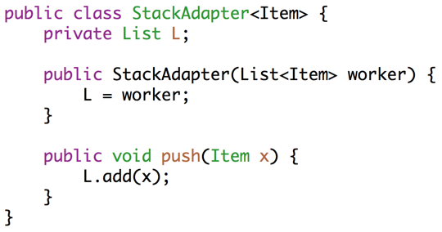

Implementing Special Cases: Extension, Delegation, Adaptation
Lecture 17 retrospective: Suppose we have a List of some type. How do we get a Stack?
Approach #3 from lecture 17 was adaptation.

Slide 51
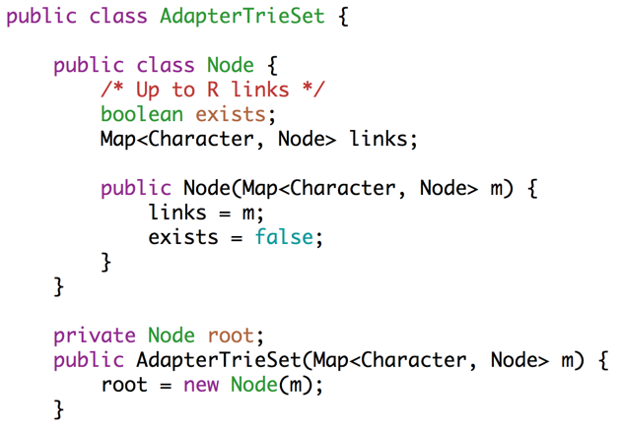
Approach #2: Use the idea of Adaptation?
What is wrong with the idea below?

Slide 52
Tweaking the Adapter Idea
Every time we create a node, we need a new map.
What should we provide to the AdapterTrieSet constructor?

Slide 53
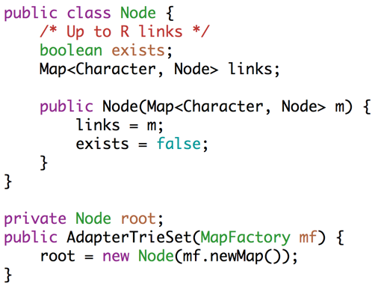
Approach #3: Give the AdapterTrieSet a Factory.
Every time we create a node, we need a new map.
AdapterTrieSet needs ability to generate new maps of some specific type.
Needs a “factory”.

Slide 54
Citations
T9 text slides and interview question: Kevin Wayne, Princeton University

